Slide 1

DSA0304-NATURAL LANGUAGE PROCESSING
`
AI-Powered Translation and Contextual Interpretation of Ancient Telugu Inscriptions Using Large Language Models
Presented by:
B. Pallavi (192424243)
A. Ashriktha Reddy(192424172)
B Akshaya (192424336)
Ch Haritha (192425280 )
Guided by:
Dr. DEVI T

Slide 2

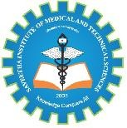
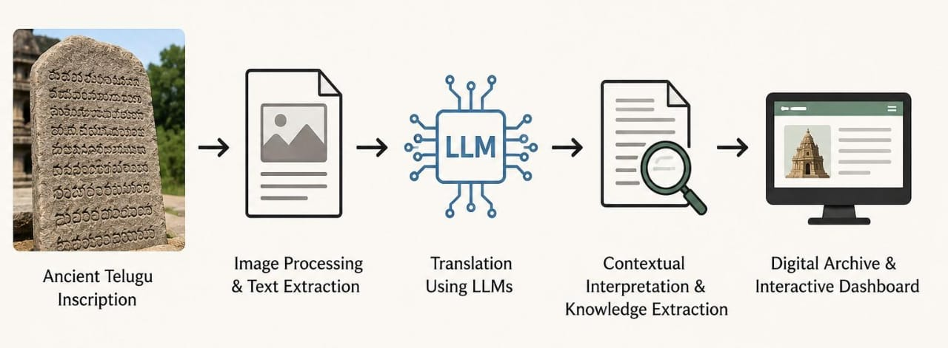
INTRODUCTION
Ancient Telugu inscriptions preserve valuable historical cultural knowledge.
These inscriptions reveal social, political, religious historical information.
Damaged inscriptions create difficulties during traditional manual interpretation.
Artificial intelligence enables efficient processing of historical inscriptions.
Image processing improves inscription clarity for text extraction.
Interactive dashboards provide convenient access to historical information.

Slide 3
OBJECTIVES
Translate ancient Telugu text into modern Telugu and English using Large Language Models (LLMs).
Understand the historical context of inscriptions by identifying important people, places, dates, and events.
Extract Telugu text from damaged, faded, or unclear inscriptions.
Extract historical and cultural knowledge using NLP techniques such as NER and Information Extraction.
Create a digital archive and interactive dashboard for easy searching, viewing, and preservation of inscription data.
Improve accessibility to ancient Telugu historical information for researchers, students, and the general public.

Slide 4
PROBLEM STATEMENT
Ancient Telugu inscriptions contain valuable historical and cultural information.
Many inscriptions are damaged, faded, or unclear, making them difficult to read.
Manual reading and interpretation of inscriptions is time-consuming and requires experts.
Existing OCR systems may not work effectively on ancient or damaged Telugu text.
Translating and understanding the historical context of inscriptions is challenging.
Therefore, an AI-based system using OCR, NLP, and LLMs is needed to extract, translate, interpret, and preserve this information digitally.

Slide 5
LITERATURE REVIEW
Year | Authors / Study | Method / Technology | Key Findings | Limitation / Research Gap
2022 | Assael et al. – Restoring and Attributing Ancient Texts Using Deep Neural Networks | Ithaca, Deep Neural Networks | Restored damaged ancient Greek inscriptions and predicted their geographical and chronological information. | Focused mainly on Ancient Greek; does not address Telugu inscriptions or LLM-based translation. (DOI)
2022 | Dhanikonda et al. – An Efficient Deep Learning Model for Telugu OCR | Deep Learning, segmentation and tagging | Proposed an efficient deep-learning approach for Telugu OCR and addressed the complexity of Telugu characters. | Designed for Telugu OCR generally, rather than damaged ancient inscriptions and contextual interpretation. (Wiley Online Library)
2023 | Vijaya Saradhi et al. – Comprehensive Study of Deep Learning Based Telugu OCR | CNN, OCR, text segmentation | Reviewed deep-learning techniques for Telugu OCR and highlighted the importance of OCR for digitizing Indian-language historical records. | Survey-based work; does not provide an end-to-end system for inscription translation and knowledge extraction. (Ijsra)
2024 | Wannaz & Miyagawa – Assessing Large Language Models in Translating Coptic and Ancient Greek Ostraca | LLMs, Machine Translation, NLP | Evaluated 9 LLMs for translating ancient texts and found that some models can assist human experts, while hallucination remains a concern for low-resource languages. | Focused on Coptic and Ancient Greek, not Telugu; requires human verification for reliable historical translation. (ACL Anthology)
2026 | Cullhed – Instruction-Tuning Pretrained Causal Language Models to Restore Ancient Greek Papyri and Inscriptions | Llama 3.1 8B, instruction tuning | Explored fine-tuning LLMs to restore missing characters in ancient inscriptions and papyri. | Focuses on restoration of Ancient Greek; Telugu inscription translation, entity extraction and digital archiving remain open areas. (OUP Academic)

Slide 6
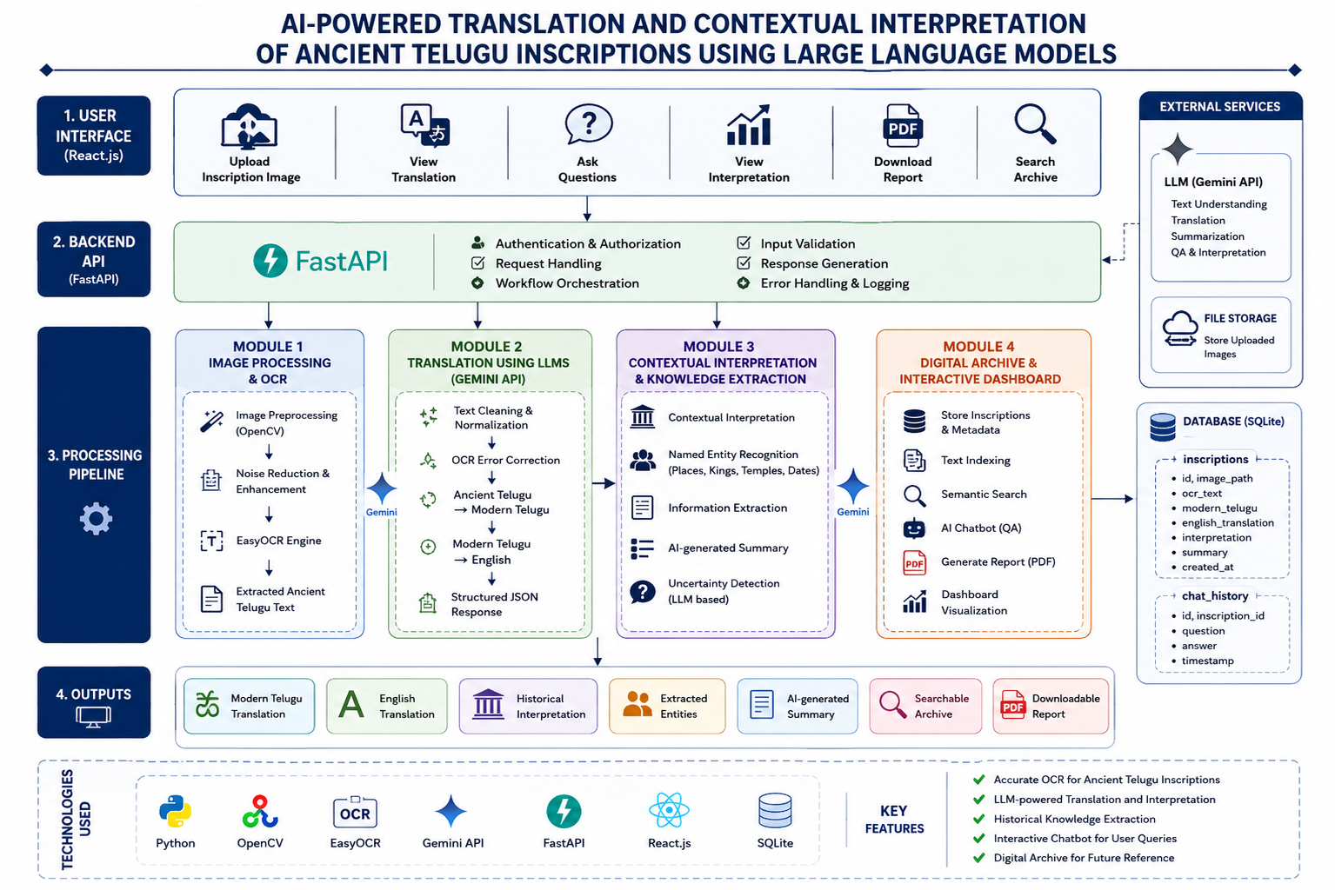
ARCHITECTURE DIAGRAM

Slide 7
MODULE 1: Image Processing and Text Extraction
Captures ancient Telugu inscription images for digital processing.
Enhances inscription images using advanced image preprocessing techniques.
Removes noise and improves visibility of faded characters.
Detects Telugu characters from processed ancient inscription images.
OCR extracts readable text from enhanced inscription images.
COMPUTER VISION TECHNIQUES
Image Preprocessing
Grayscale Conversion
Noise Removal
Optical Character Recognition (OCR)
SOFTWARE/TOOLS USED
Python
OpenCV
EasyOCR

Slide 8
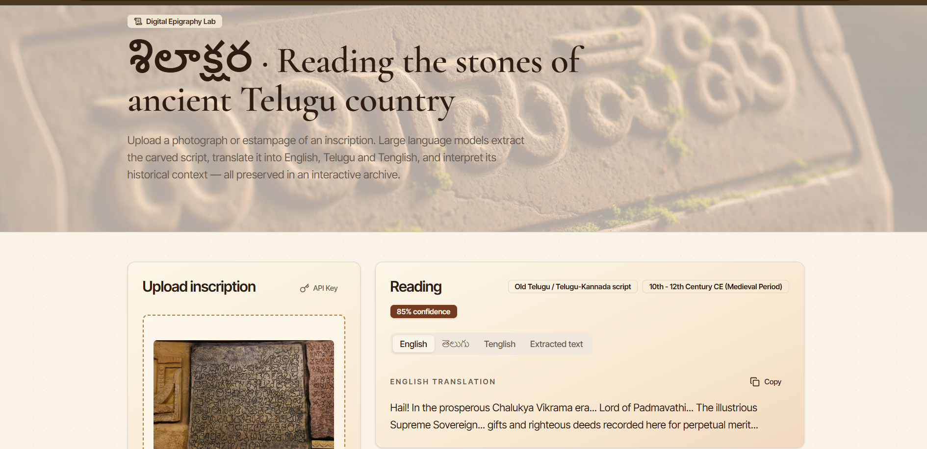
MODULE 1: Implementation

Slide 9
MODULE 2:Translation Using Large Language Models (LLMs)
Converts ancient Telugu text into modern Telugu and English.
Uses Large Language Models (LLMs) for intelligent translation.
Understands the context and meaning of historical inscriptions.
Preserves cultural and historical information during translation.
Generates accurate, fluent, and easy-to-read translated text.
Provides translated output for contextual interpretation and knowledge extraction.
NLP TECHNIQUES
Text Preprocessing
Unicode Normalization
OCR Error Correction
Machine Translation
SOFTWARE/TOOLS USED
Python
Gemini API (LLM)

Slide 10
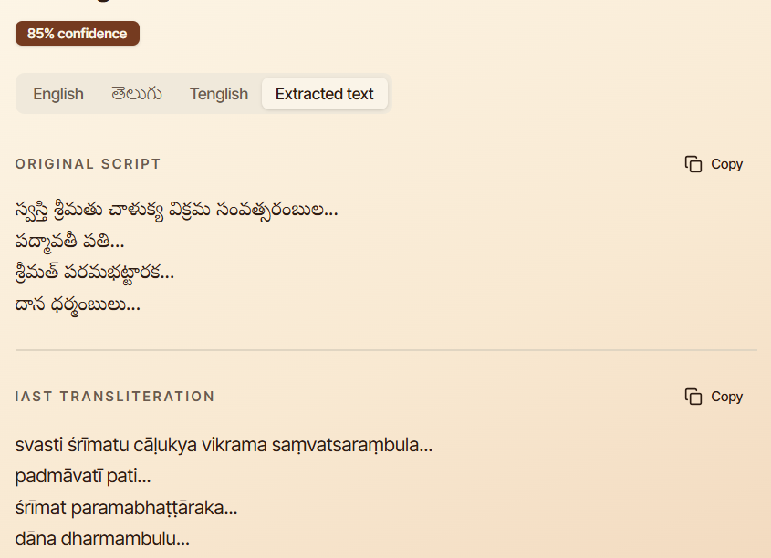
MODULE 2: Implementation

Slide 11
MODULE 3:Contextual Interpretation and Knowledge Extraction
Analyzes the translated text to understand its historical context.
Identifies important entities such as kings, places, temples, and dates.
Extracts valuable historical, cultural, and religious information.
Determines relationships between people, locations, and events.
Generates a meaningful summary of the inscription's content.
Produces structured knowledge for storage and further analysis.
NLP TECHNIQUES
Named Entity Recognition (NER)
Information Extraction (IE)
Relation Extraction
Text Summarization
Knowledge Extraction
Semantic Analysis
SOFTWARE/TOOLS USED
Python
Gemini API (LLM)

Slide 12
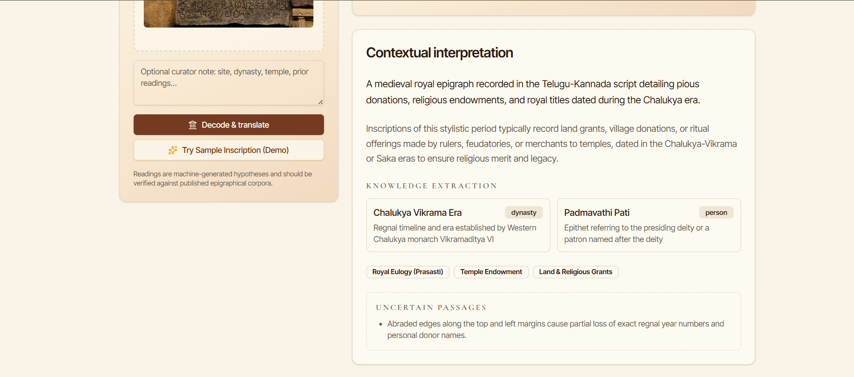
MODULE 3: Implementation

Slide 13
MODULE 4:Digital Archive and Interactive Dashboard
Stores translated inscriptions in a secure digital archive.
Provides an interactive dashboard to view and manage inscription data.
Enables searching by dynasty, place, king, or historical period.
Displays original images alongside translated and interpreted text.
Visualizes historical insights using charts and graphs.
Allows users to download reports and explore inscription records easily.
NLP TECHNIQUES
Information Retrieval (IR)
Text Indexing
Semantic Search
Metadata Generation
Question Answering (Chatbot)
SOFTWARE/TOOLS USED
React.js
FastAPI
SQLite
Gemini API

Slide 14
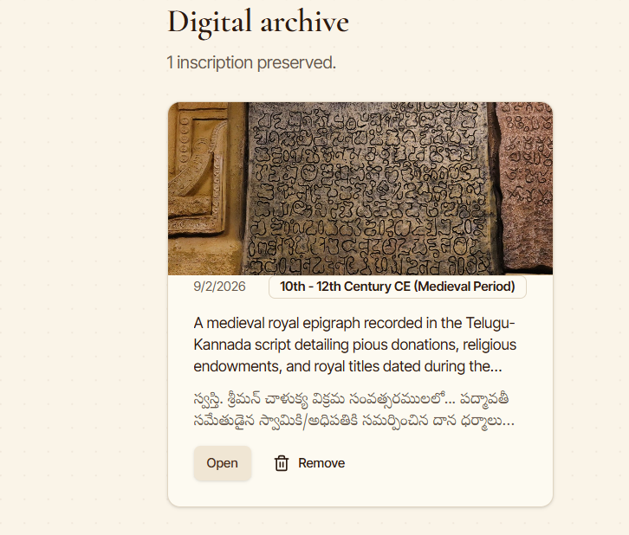
MODULE 4: Implementation

Slide 15
RESULTS
Ancient Telugu inscription images can be enhanced using image preprocessing techniques.
OCR helps extract Telugu text from inscription images.
The extracted text can be converted into modern Telugu and English using an LLM.
NLP techniques can identify kings, places, temples, dates, and historical events.
The system can generate summaries and structured historical information.
A digital archive can make inscriptions easier to search, preserve, and access.
AI-based ancient-text research has already shown strong potential for restoration and contextual interpretation in other ancient languages.

Slide 16
CONCLUSION
The proposed system combines Computer Vision, OCR, NLP, and LLMs for studying ancient Telugu inscriptions.
It helps transform difficult-to-read inscription images into readable and meaningful information.
LLM-based translation can improve access to historical content in modern Telugu and English.
Contextual interpretation helps researchers understand the historical and cultural significance of inscriptions.
The digital archive provides a convenient way to preserve and retrieve ancient knowledge.
The system can be further improved with larger Telugu inscription datasets, specialized Telugu models, and expert validation.
Overall, the project demonstrates how AI can support the preservation and interpretation of Telugu cultural heritage.

Slide 17
REFERENCES
Assael, Y., Sommerschield, T., Shillingford, B., et al. (2022). “Restoring and Attributing Ancient Texts Using Deep Neural Networks.” Nature, 603, 280–283.
Dhanikonda, S. R., Ponnuru, S., Ramanaiah, M. L., et al. (2022). “An Efficient Deep Learning Model with Interrelated Tagging Prototype with Segmentation for Telugu Optical Character Recognition.” Scientific Programming.
Sonthi, V. K., Nagarajan, S., & Krishnaraj, N. (2022). “Deep Learning Based Residual Network Features for Telugu Printed Character Recognition.” Intelligent Automation & Soft Computing, 34(3), 1725–1736.
Suresh, G., Prasad, C. R., & Kollem, S. (2022). “Telugu Optical Character Recognition Using Deep Learning.” 3rd International Conference for Emerging Technology (INCET).
Nair, B., Raj, K. V., Mangalath, K., Pai, V., & Sreejil, E. V. (2023). “Ancient Epic Manuscript Binarization and Classification Using False Color Spectralization and VGG-16 Model.” Procedia Computer Science, 218, 631–643.
Priya, R., Karthikeyan, S., Indra, J., et al. (2023). “Self-Adaptive Hybridized Lion Optimization Algorithm With Transfer Learning for Ancient Tamil Character Recognition in Stone Inscriptions.” IEEE Access.

Slide 18
THANK YOU

